Slide 1
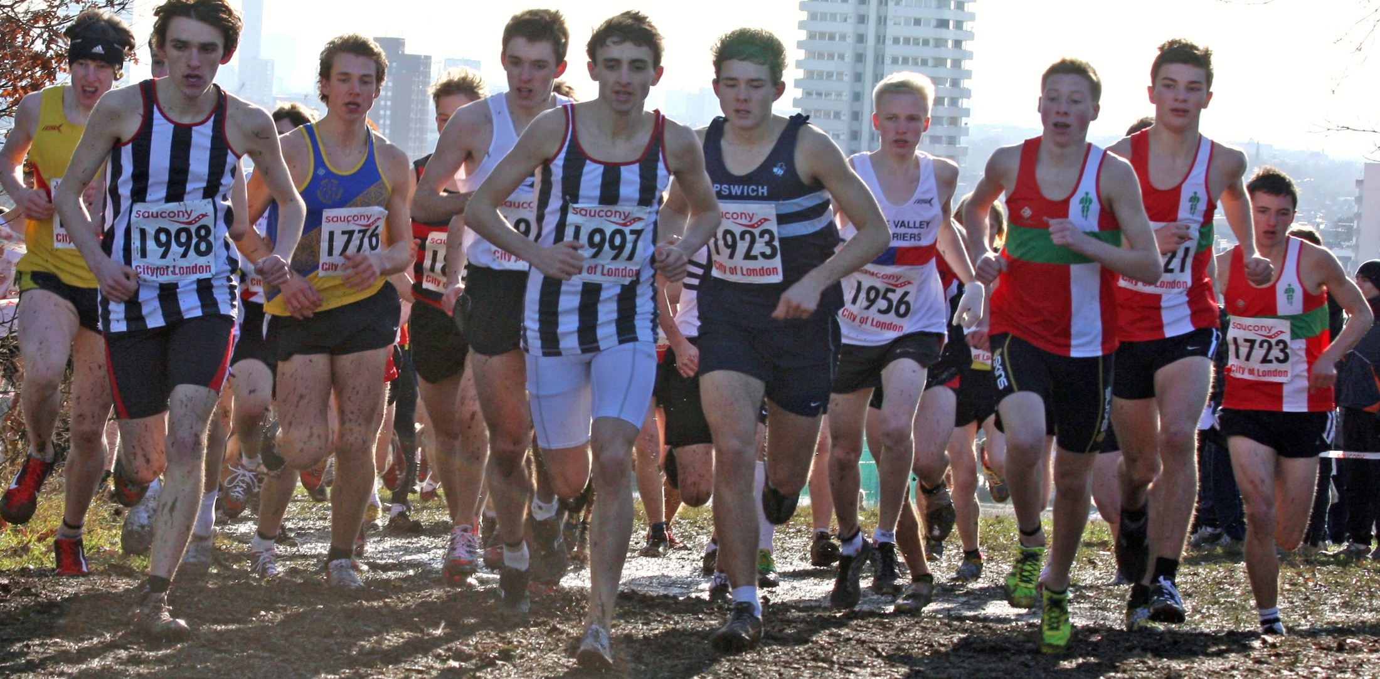
Welcome to Lee Valley Athletics Centre London and South East ACM Programme Presentation on coaching emerging teenage athletes Key elements to be covered:- 1. Basic principles of training in relation to endurance running 2. Using physiological concepts: VO2 Max. Maximum Heart Rate and Anaerobic Threshold 3. A generic model for planning Training and Competition Geoffrey Williams UKA Level 4 Performance Coach

Slide 2
Theory/Practice of Acquired Endurance
Acquisition of Technique
Duration systems
Repetition systems
Appropriate competition
and training
Niall Fleming Shaftesbury Barnet Harriers

Slide 3
Duration runs
Continuous steady running at the same pace or intensity
Governed by Heart Rate in the 125 – 160 bpm zone
Duration of between 30 minutes at ‘age’ 13/14 to 70 – 110 minutes for the fully grown athlete
Improvement of VO2 maximum i.e. Aerobic capacity. Long term loading under aerobic conditions
If repeated throughout the year the benefits are retained
Best way to introduce use of HRM
Alternating pace or intensity
Long runs which include changes to the pace of running.
Demands discipline from the athlete
Benefits from the slower pace being at least double the time spent running at the faster pace. HRM helps greatly in controlling this.
Key issue is for faster pace to be anaerobic (160 – 180 bpm) work but slower pace must be recognised as a pay back period of ‘rest’ (120-140bpm).
Fartlek styled sessions
Terrain and/or individual needs dictate pace and intensity
Hills introduce anaerobic periods of work, flat/downhill terrain simulate pay back period of ‘rest’. Much more difficult for the younger athlete to grasp both intellectually and in practice.
Retention of this aerobic base is a key factor in success

Slide 4
Repetition
This is all about variables to achieve goals
Distance or time of run – all coaches have their own terminology – I advocate ‘time on your legs’ rather than ‘mileage distances’.
How much rest – how do we measure this?
Intensity of the repetition – how fast; how far in metres; how long in time; what % VO2 max.
How many repetitions and are they done in sets?
What type of recovery – standing still; walking; jogging etc.
Underfoot conditions – sand; grass; track; pavement.

Slide 5
Interval Training:
Chief positive effect – rapid development of aerobic endurance
Chief draw back effect – beneficial effects are lost relatively quickly compared to ‘Duration’ methods.
Key factors:-
If done with a HRM:
a) Intensity must raise HR to top of training zone (170–190 bpm)
b) Repeat when HR returns to lower end of training zone (120 – 135 bpm) in jogging mode
c) Control number of repetitions - Increase number of repetitions over time DENSITY not VOLUME.
d) More reliable results if done over a measured course (track or grass).

Slide 6
Speed Endurance Training
General rules for progress
Increase number of repetitions but not necessarily the speed
5 x 300m in 50secs off 80 secs rest becomes 10 x 300m with same rest – i.e. Greater volume to sessions which the athlete needs to get used over time.
Standardise intensity and recovery time e.g. 10 x 300m in 50secs with 80 secs rest
Slowly increase intensity of reps but maintain same recovery time e.g. 10 x 300m in 48secs with 80secs rest
Reduce the number of reps and introduce sets e.g. 2 sets x 5 reps x 300m in 46secs with 80secs rest between reps and a full recovery of 4 mins (jogging) between sets. i.e. Increases DENSITY without affecting quality.
Slowly shorten recovery between reps e.g. 2 sets x 5 reps x 300m in 46secs with 50secs rest between reps and a full recovery of 4 mins (jogging) between sets.
Key requirement is quality of the run while times of reps must remain the same throughout any given session
‘Challenge type’ Down the clock sessions: e.g. 400m on the track at a set time (66secs – 80secs i.e. At a pace easily managed by the athlete) repeated with a 5 secs reduction in rest after each repetition starting at 75secs(?) Key session for testing progress and mindset of athlete.
Athletes need to learn pace judgement (before) moving onto this type of speedwork.
Aims to produce high quality performance despite the onset of anaerobesis
During the winter phase of training more reps at a slightly slower pace works well
During the competition season less reps at a faster speed works well

Slide 7
Stength Endurance Training
Defined Strength Endurance sessions
2 x 5 x 80 metres running hard ‘back to back’
6 x 150 metres (25-39secs in duration) uphill on concave hill with no more than 3 times running recovery (90 – 120 secs)
This is a much misunderstood concept and the major failing of inexperienced coaches who mistakenly allow their FUNdemental activities done with the 10 – 13 years age group to be done too intensely – wear and tear on the body is considerable and therefore must be monitored carefully. NOT TO BE EXPERIMENTAL
Now the athlete is experiencing lactic anaerobesis.
Recovery perameters MUST BE ADHERED TO for this to type of training to work well.
Very high intensity running with relatively short rest
BUT depreciation of quality is natural and acceptable.
No need to record training performances
Best done in October/November/December

Slide 8
Competition and Testing
Provide opportunities for development of specific qualities in an athlete’s learned experience.
Simulates relevant demands met in races
Strengthens competitive mindset
Empowers athlete to make decisions quickly and accurately
Specific time trials
e.g. Over distance trial at 85% effort and under distance trial at maximum effort
Intra race varied speed time trials
e.g. 600m in 100 secs with one of the 200metre units run at a faster pace
Practice of technical elements of competition
Recognisation of pace and ability to react to probabilities.

Slide 9
Finding your Maximum Heart Rate
Finding maximal heart rate (MHR) helps us to calculate training heart rates which are usually expressed as a % of MHR.
A rough way is 214-(.8 x age) for men and 209-(.9 x age) for women.
More accurate measurement can be made using a Heart Rate Monitor (HRM). If you have a HRM which can store information for downloading onto a computer so much the better.
Testing Method:
Rest on the day before the test
Ensure the athlete is warmed up properly (do this slowly as if preparing on race day) and the HRM is working well (wear it during warm up).
Set up the test on a treadmill where the coach has more control over the intensity of the test
Run for 3 minutes at a level pace but comfortably fast. The treadmill can be set for this.
At the end if the 3 minutes jog for a minute (pace governed by treadmill) and repeat the 3 minute run.
The MHR will probably be recorded in the last minute rather at the end of the 3 minute run.

Slide 10
Calculating your Threshold Heart Rate (THR) Modified after Conconi
Finding your Threshold Heart Rate (THR) gives the coach an accurate and individual record of an athlete’s heart beat parameters.
If you plotted your heart rate against speed on a graph, there would be a clear point at which the gradient of the line changed. This is referred to as the ‘deflection point’ and is said to be the anaerobic threshold level.
The key benefit for the coach is that he/she can control the intensity of each training session bearing in mind an individual athlete’s threshold level.
Testing Method:
Rest on the day before the test
Ensure the athlete is warmed up properly (do this slowly as if preparing on race day) and the HRM is working well (wear it during warm up).
Set up the test on a treadmill where the coach has most control over the increasing intensity of the test.
The coach increases the speed of the treadmill every 30 secs by 0.5kph and the athlete’s pulse is recorded at the same time as the speed is increased.
The athlete continues until any increase in treadmill speed results in him/her being unable to continue. They then warm down in the same way after a training session or competitive run.
Plot the results on a graph to show time on the vertical axis and speed on the horizontal axis.
The anaerobic threshold is where the point of deflection occurs.

Slide 11
Planning schedules: First principles Take the foundation or preparation phase as being September to January.
14/15 Year old Male athlete of good standard
16/17 Year old Male athlete of County standard +
Emphasis is on aerobic work, skills and drills and long repetitions at 10% - 15% below threshold in the proportions of 50% - 20% - 30%
Sunday: Long run with others at no higher than 150bpm (dependent on individual). 45 – 60 mins.
Monday: REST
Tuesday: 8 x 2/3 mins @ close to threshold off 90secs jogging. Follow with strides. Looking to do at least 1.5 x race distance
Wednesday: Recovery run of no more than 30 mins
Thursday: Drills followed by 2 x 5 x 400 metres @ 70 – 75 secs on track off 90 secs with 3 minutes active rest between sets. Carefully monitor speed.
Friday: REST
Saturday: Either supervised Fartlek session on appropriate terrain or 6 – 8 x Hilly loops of at least 2 minutes which include different types of hill and camber.
Total minutes including warm-up/cool downs = 250 minutes
Emphasis is on aerobic work, and long repetitions at just below threshold in the proportions of 60% - 40%
Sunday: Long run with others at no higher than 150bpm (dependent on individual). 60 – 100 mins.
Monday: 35 mins with 5 slow easy mins followed by 5 strong mins (close to threshold)
Tuesday: 2-3-4-5-5-4-3-2 mins @ chosen bp (in effect a level which ensures completion of the session without stress) off 75 secs active. Follow with strides. Looking to do at least 1.5 x race distance
Wednesday: Recovery run of 50 – 80 mins very easy (135 – 150bpm dependent on athlete)
Thursday: Drills followed by 20 x 400 metres @ 66 – 72 secs on track off 90 secs. Carefully monitor speed.
Friday: REST (swim/massage)
Saturday: 6 – 8 x Hilly loops of at least 3 minutes which include different types of hill and camber. Follow with strides
Total minutes including warm-up/cool downs = 400 minutes

Slide 12
Working with athletes in the 18 -20 age groups
Emphasis is on aerobic work, and long repetitions at just below threshold in the proportions of 50% - 50%
Assumption is that these athletes are at University or on a gap year
Sunday: Long run with others at no higher than 150bpm (dependent on individual). 80 - 110 mins.
Monday: 50 mins @ 150bpm
Tuesday: 5-5-2-8-2-5-5 mins @ chosen bpm (again at a level which ensures completion of the session without stress) off 60 secs active. Follow with strides. Try interjecting slightly faster pace for both 2 min efforts. Looking to clear 30 - 36 mins of quality work in this session. All done on level grass.
Wednesday: Recovery run of 50 – 80 mins very easy (135 – 150bpm dependent on athlete)
This is where consideration of doubling up comes in i.e. 30 mins am @ 145 bpm and 45 mins pm @ 160+ bpm
Thursday: Drills followed by 2 x 10 x 400 metres @ 66 – 68 secs on track off 60 secs. Carefully monitor speed. Complition is the key factor here and grass surface may be preferred
Friday: REST (swim/massage/core work)
Saturday: Either double up as for Weds or longer fartlek session in a groups according to ability.
Much greater emphasis on aerobic ‘time on the legs’
e.g. 1 day doubling up with easy run am @140bpm followed by stronger run pm @ 160bpm. Duration depends on stage of development.
Introduction of more core specific work and circuits.
All testing is done in laboratory conditions to ensure absolute accuracy.
Refinement of speed endurance sessions. More work on longer reps done at closer to threshold pace.
Medical support must be in place at this age.

Slide 13
Some personal thoughts
Appropriate rest is the key to success – it needs to be managed well.
Realistic goals for individual needs. Teenagers are not adults so treat them accordingly.
Keep them happy and remember WHY you are coaching!
Managing numbers/abilities must be mastered early on in a coaches career
Develop a strategy for your coaching – what and when – how much time can you afford to give to coaching – you only get out what you put in!
YOUR EYES SUPPLY INFORMATION – watch your athletes train and race
Understanding correct techniques – thoroughly understand the biomechanics of running – make this an initial learning target for yourself.
Analysis of technique. Can you spot and correct poor technique?
Pace judgement is a key factor so spend time getting athletes familiar with pace – initially on the track where they have points of reference.
The value of hills (up and down) – the gradient supplies the resistance so no need to run them hard.
Selection of appropriate competition. Youngsters want to run as often as possible and are always trying to set a new pb. BUT ..............
Transparent and shared planning for training and competition – get to know your athletes – share thoughts, listen empathetically, avoid the ‘I know what I am doing just do what you are told’ philosophy
Practice race tactics – equip your athletes for races conditions.
Time trials and paced races should be carefully slotted into schedules
Value testing and execute accurately – an essential tool for you as a coach.
A strong Support system must be in place – physio/massage
Sharing knowledge = acquiring knowledge for coach and athlete. Talk to other coaches on a regular basis. DO NOT WORK IN ISOLATION

